Slide 1
Software Engineering

Slide 2
Recommended Books-
Software Engineering, A Practitioner's Approach (6th / 7th Edition) by ROGER S. PRESSMAN
Software Engineering by Ian Sommerville, Addison-Wesley

Slide 3
An Introduction to Software Engineering

Slide 4
What is Software?
Software is
instructions (computer programs) that when executed provide desired function and performance,
data structures that enable the programs to adequately manipulate information, and
documents that describe the operation and use of the programs.

Slide 5
Dual Role of Software
Software is a product
-Delivers computing potential (capability)
-Produces, manages, acquires, modifies, displays, or transmits information
Software is a vehicle (medium) for delivering a product
-Supports or directly provides system functionality
-Controls other programs (e.g., an operating system)
-Effects communications (e.g., networking software)
-Helps build other software (e.g., software tools)

Slide 6
The Role of Software Engg.
The role of software engineering is to capture the customer’s business needs and specify the “blueprints” for the system so that programmers can implement it.

Slide 8
Objectives of Software Engineering
Understanding user conceptual model & development of better specification.
Improvement in design languages & reusable code.
Specification of interface & mockup to confirm specification.
Improving the quality of the software products.
Increasing the productivity & Giving job satisfaction to the software engineers.

Slide 9
Importance of Software Engineering
More and more, individuals and society rely on advanced software systems. We need to be able to produce reliable and trustworthy systems economically and quickly.
It is usually cheaper, in the long run, to use software engineering methods and techniques for software systems rather than just write the programs as if it was a personal programming project. For most types of system, the majority of costs are the costs of changing the software after it has gone into use

Slide 10
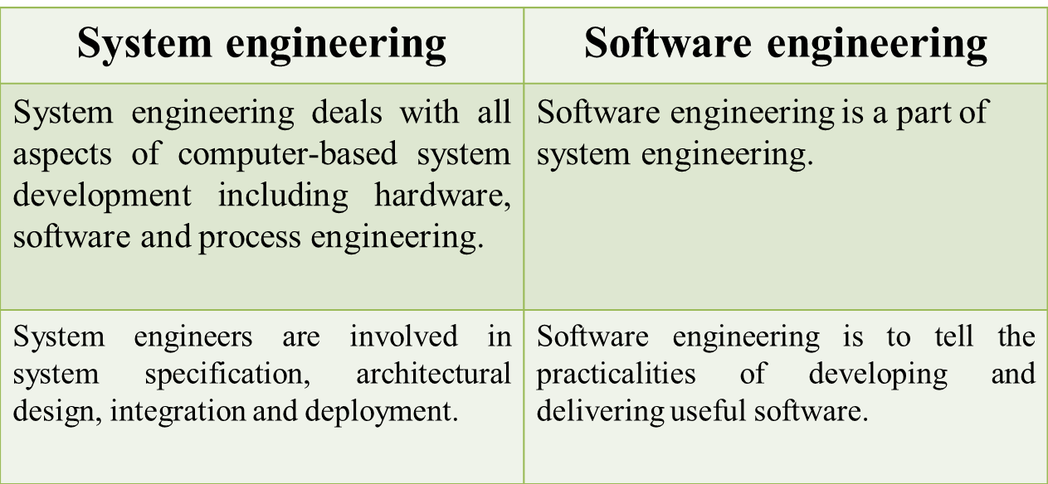
What is the difference between software engineering and system engineering?

Slide 11
Software Characteristics
Software is developed or engineered, it is not manufactured in the classical sense.
Software doesn't "wear out”.
The industry is moving toward component-based assembly, most software continues to be custom built.

Slide 12
Software is developed or engineered, it is not manufactured
Some similarities exist between software development and hardware manufacture,
-the two activities are fundamentally different.
High quality is achieved through good design, ⇨ in both case
In manufacturing phase for hardware can
introduce quality problems that are nonexistent (or easily corrected) for software.
Both activities are dependent on people

Slide 13
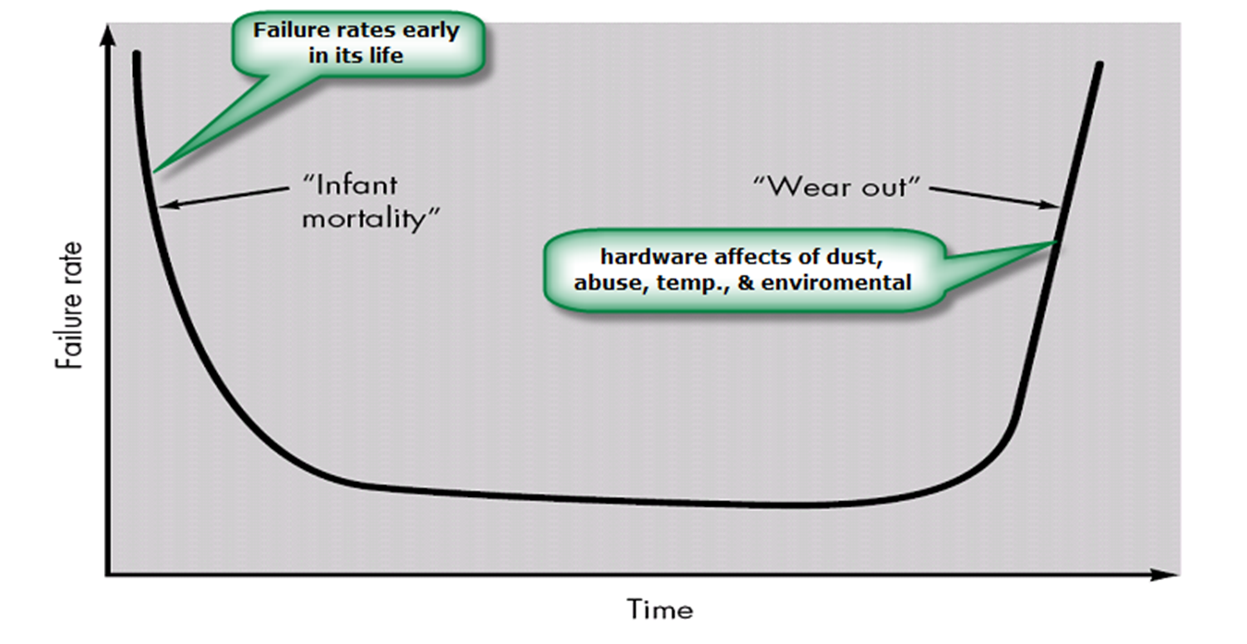
Software doesn't "wear out”
For Hardware

Slide 14
Software doesn't "wear out”
As time progresses, the hardware components start deteriorating
-they are subjected to environmental maladies such as dust, vibration, temperature etc. and at some point of time they tend to breakdown.
The defected components can then be traced and replaced .

Slide 15
Software doesn't "wear out”
But, software is not susceptible to the environmental changes .
So Do, it does not wear out.
The software works exactly the same way even after years it was first developed unless any charges are introduced to it.
The changes in the software may occur due to the changes in the requirements .And these changes may introduce some defects in it thus, deteriorating the quality of software .So, software need to maintained properly.

Slide 16
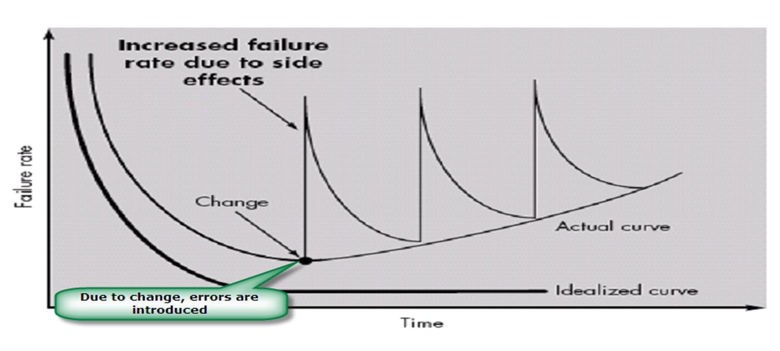
Software doesn't "wear out”
For Software

Slide 17
Software continues to be custom built
Most of the engineered products are first designed before they are manufactured, Designing includes identifying various components for the product before they are actually assembled.
Here several people can work independently on these components thus making the manufacturing system highly flexible.

Slide 18
Software continues to be custom built
In software, breading a program into modules is difficult task , since each module is highly interlinked with other modules.
Further, it requires lot of skill to integrate different modules into one .Now a days the term component is widely used in software industry where object oriented system is in use.

Slide 19
What are the attributes of good software?
The software should deliver the required functionality and performance to the user and should be maintainable, dependable and acceptable.
Maintainability
Software must evolve to meet changing needs;
Dependability
Software must be trustworthy;

Slide 20
What are the attributes of good software?
Efficiency
Software should not make wasteful use of system resources;
Acceptability
Software must be accepted by the users for which it was designed. This means it must be understandable, usable and compatible with other systems.

Slide 21
Software change
Software change is inevitable (essential):
New requirements emerge when the software is used;
The business environment changes.
Discovered errors must be repaired.
New computers and equipment are added to the system.
The performance or reliability of the system may need to be improved.

Slide 22
Software Evolution
Software evolution is the term to refer to the process of developing software initially, then repeatedly updating it for various reasons.

Slide 23
Importance of evolution
Organizations have huge investments in their software systems - they are critical business assets.
To maintain the value of these assets to the business, they must be changed and updated.
The majority of the software budget in large companies is devoted to evolving existing software rather than developing new software.

Slide 24
Software crisis-Problem
The problem list included software that was
Unreliable
Delivered late
Prohibitive in terms of modification costs
Impossible to maintain
Performing at an inadequate level
Exceeding budget costs

Slide 25
Software crisis-Problem
The crisis manifested itself in several ways:
Projects running over-budget.
Projects running over-time.
Software was very inefficient.
Software was of low quality.
Software often did not meet requirements.
Projects were unmanageable and code difficult to maintain.
Software was never delivered

Slide 26
Software crisis Cause
Bad planning or run time decisions.
Lack of documentation.
Improper assessment.
Incorrect estimates of needed resources.
Impractical project goals.
Not a good communication among customers, developers and users.
Use of undeveloped technology.
Not a good project management.

Slide 27
Software Applications
System software: such as compilers, editors, file management utilities.
Application software: stand-alone programs for specific needs.
Real-time software: Software that monitors/analyzes/controls real-world events as they occur is called real time.
Personal computer software: The personal computer software market has burgeoned over the past two decades. Word processing, spreadsheets, computer graphics, multimedia, entertainment, database management.
Engineering/scientific software: Characterized by “number crunching “algorithms such as automotive stress analysis, molecular biology, orbital dynamics etc.

Slide 28
Software Applications
Web-based software: The Web pages retrieved by a browser are software that incorporates executable instructions (e.g., CGI, HTML, Perl, or Java), and data.
Embedded software resides within a product or system. (key pad control of a microwave oven, digital function of dashboard display in a car).
Product-line software focus on a limited marketplace to address mass consumer market. (word processing, graphics, database management)
WebApps (Web applications) network centric software. As web 2.0 emerges, more sophisticated computing environments is supported integrated with remote database and business applications.
Artificial intelligence software uses non-numerical algorithm to solve complex problem. Robotics, expert system, pattern recognition game playing.

